Slide 1

Intro to
Programming
With python
Functions:
part III
Mutability
Wednesday, March 19 2025 TOH210
Notes:
Layout objects pulled from: https://slidesgo.com/
All icons are from: https://thenounproject.com/

Slide 2

functions 3
colab workbook
click for access
found on Moodle under this week

Slide 3

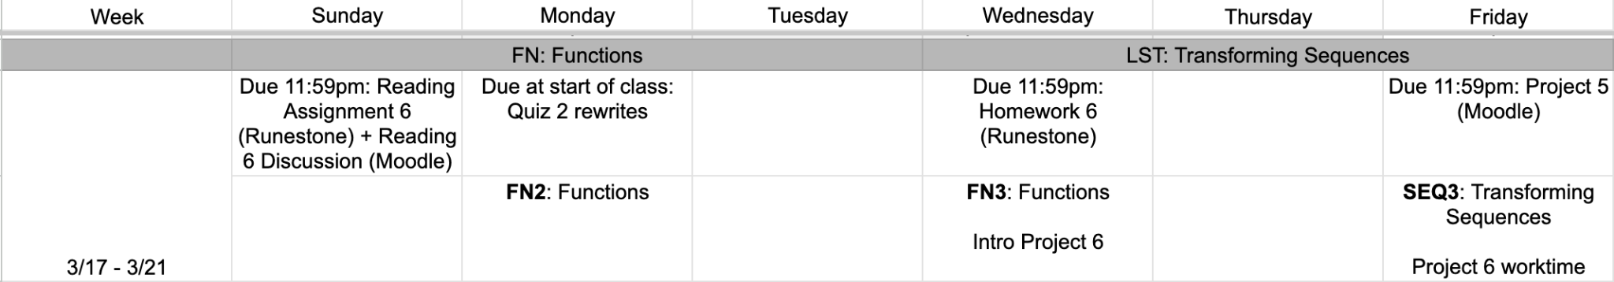
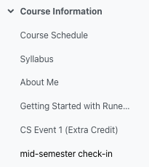
this week
google sheet link
Note for Project 5: to not have the is_legal function be flagged by the graders, do not only have a return statement
refrain from:
def is_even(num):
return num%2==0
do this instead:
def is_even(num):
if num%2 ==0:
return True
else:
return False
Notes:
https://docs.google.com/forms/d/e/1FAIpQLSe3OloPAJSid4n6cyU_4qXpRWU7FOSmP7IVdRS_vh9cvYd9zQ/viewform?usp=sharing

Slide 4
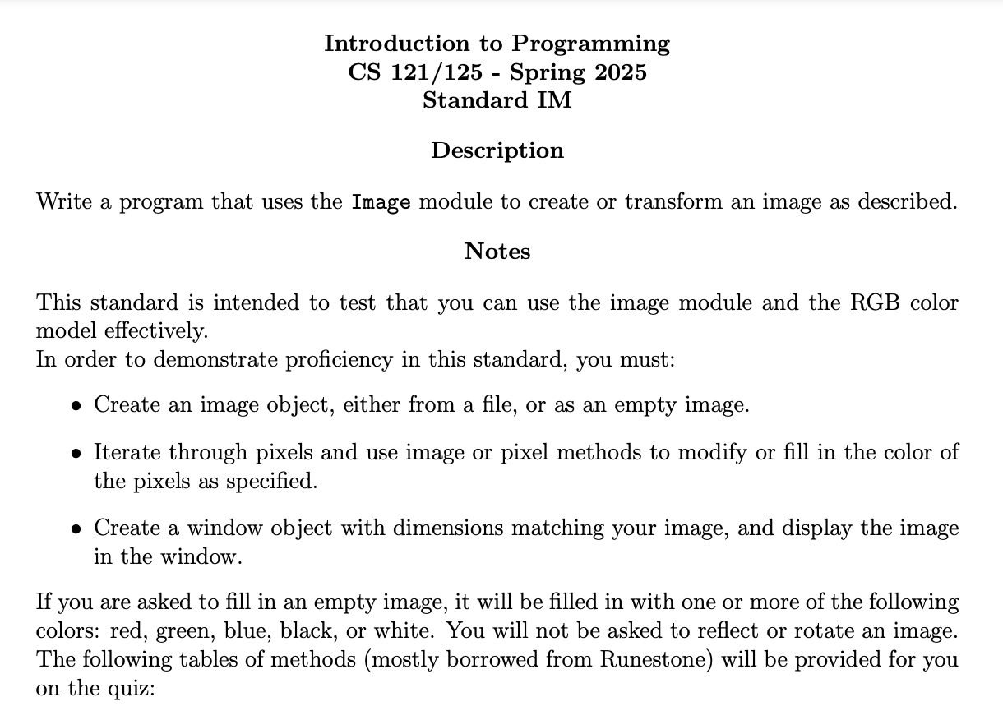
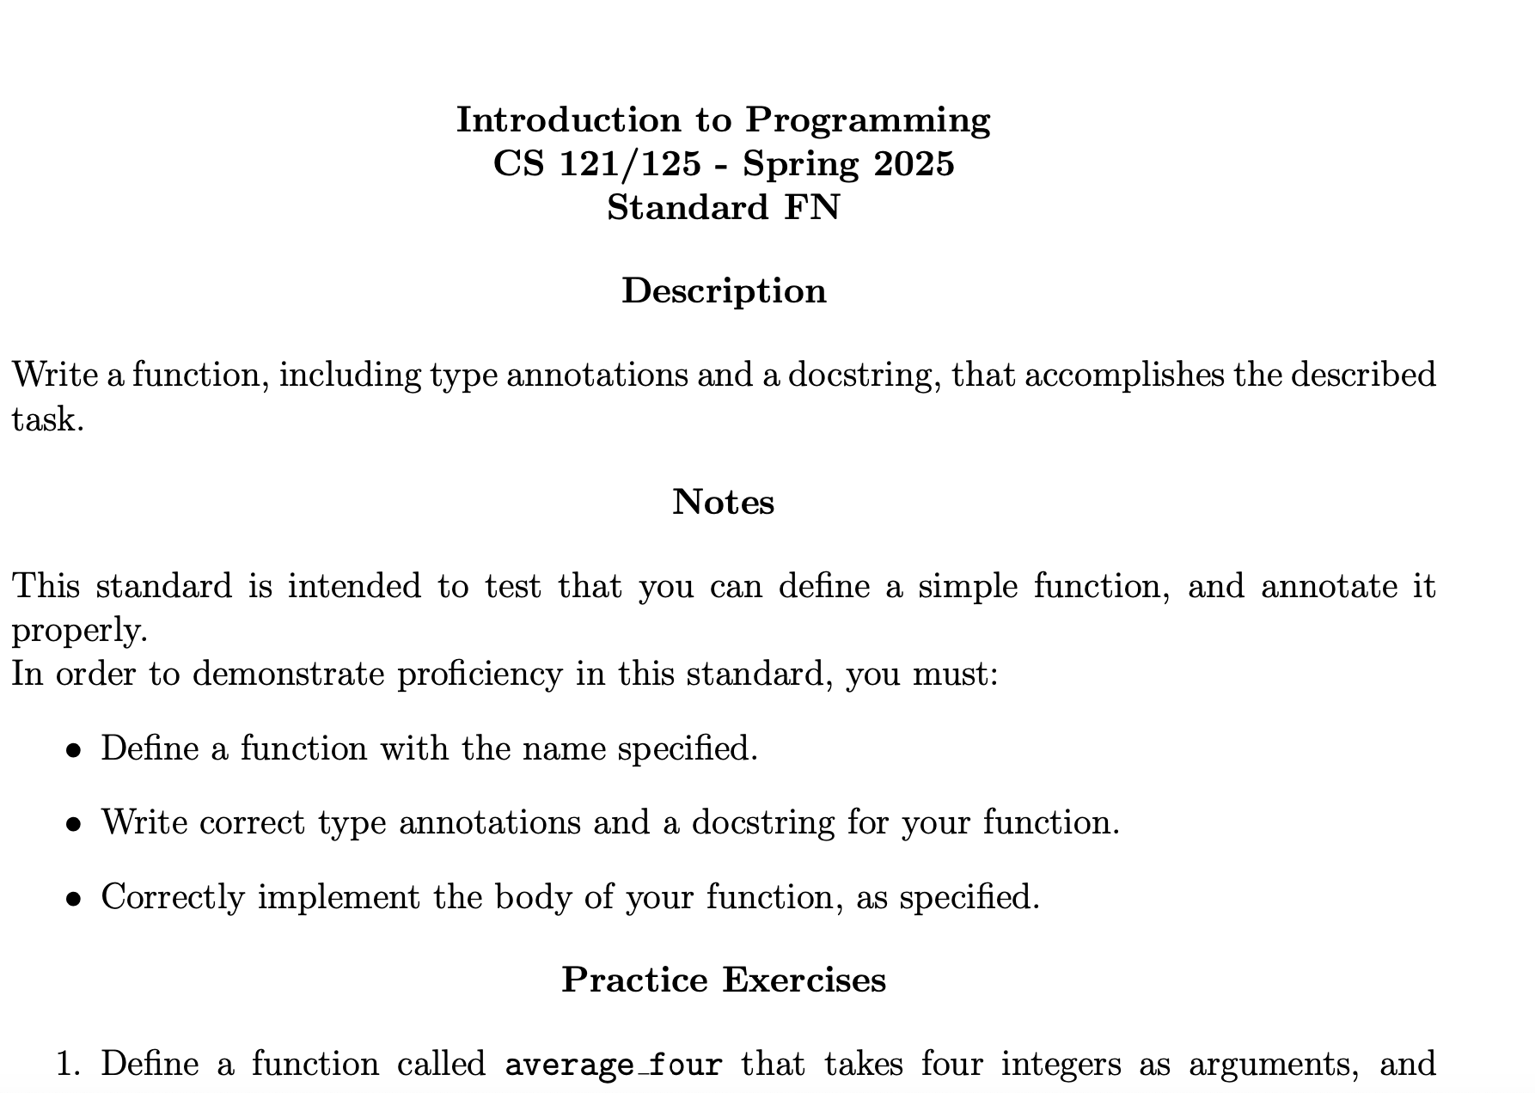
Standards IM (image) and FN (functions) are up on Moodle.
Make sure to do the practice exercises to study for our quiz next week

Slide 5


Warm-up
string separator
Define a function called print_words that takes a string as an argument, separates the string into words based on spaces, and prints each word on a separate line.
Remember to include type annotations for both the parameter and return, and a docstring.
You will also need to create a list from a string… this should sound familiar (hint: use the split method)
An example of calling your function is below:
print_words(“mushrooms are yucky”)
Should display the following:
mushrooms
are
yucky
when you’re done, throw an emoji of your favorite animal in chat

Slide 6
Takeaways from last time
documenting functions with type annotations and docstrings
functions with no arguments
functions that do not return a value
print vs return

Slide 7
when you’re done, throw an emoji of your favorite color in chat
Exercise: fill in the blanks
Define a function called find that takes a list list_of_things and a value thing, and returns the index of the first occurrence of thing in the list. If thing is not in the list, return -1
There are two methods to find indices of things for strings, find and index, but only one method for lists, index.
Let’s see how we can create our very own find function for lists!
def find(list_of_things:list, thing) -> int:
"""Takes a list (list_of_things) and a value (thing), and
returns the index of that value in the list if it exists,
otherwise returns -1."""
if thing in list_of_things:
return list_of_things.index(thing)
else:
return -1
def find(list_of_things:list, thing) -> int:
"""Takes a list (list_of_things) and a value (thing), and
returns the index of that value in the list if it exists,
otherwise returns -1."""
if thing in list_of_things:
return list_of_things.index(thing)
else:
return -1
def find(list_of_things:list, thing) -> int:
"""Takes a list (list_of_things) and a value (thing), and
returns the index of that value in the list if it exists,
otherwise returns -1."""
if thing in list_of_things:
return list_of_things.index(thing)
else:
return -1
def find(list_of_things:list, thing) -> int:
"""Takes a list (list_of_things) and a value (thing), and
returns the index of that value in the list if it exists,
otherwise returns -1."""
if thing in list_of_things:
return list_of_things.index(thing)
else:
return -1
def find(list_of_things:list, thing) -> int:
"""Takes a list (list_of_things) and a value (thing), and
returns the index of that value in the list if it exists,
otherwise returns -1."""
if thing in list_of_things:
return list_of_things.index(thing)
else:
return -1
you’ll need to add these to the code in multiple spots
thing
and some of these, but which ones? and where?
find
int
list
bool
-1
True
list_of_things
index
float
str
None
0
False

Slide 8
when you’re done, throw your favorite emoji in chat
Exercise: Finding vowels
Define a function called contains_vowel that takes a string text, and returns True if the string contains a vowel, and returns False otherwise. Use the outline below, filling in the function header first, then the function body
def contains_vowel( : ) -> : #fill this in, adding type annotations
#add docstring
has_vowel = False
vowels = ["a","e","i","o","u"]
#go through text and if letter is in vowels change has_vowel to True
#your code here
return has_vowel
word bank: you will not need everything below, and will have to create your own iterator variable
int
list
bool
True
if
elif
else
text
float
str
None
False
for
in
has_vowel

Slide 9
functions calling other functions
def fun1():
return "Hey, what's up?"
def fun2():
text = "I am bored! Let me call fun1"
calling = fun1()
print(fun2())
prints out None (i.e. nothing is returned)
Notice fun2 calls fun1, but only sets the variable calling to the string “Hey, what’s up? given by fun1’s return statement.
what will this line do?
def fun3():
text = "I am bored! Let me call fun1"
return fun1()
print(fun3())
prints out “Hey, what’s up?”
Notice fun3 calls fun1 in it’s return statement, so whatever is returned in fun1 will also be returned in fun3
what will this line do?

Slide 10
Composite functions
def addition(x, y):
return x + y
def double(x):
return x*2
print(double(addition(2,3)))
Use order of execution to find what value will be printed to the screen.
addition(2,3) is the innermost function and will be called first
addition function is called, compute 2 +3 and returns the value 5
the value returned from the addition function will then be used as the argument for the double function
double(5) → 5* 2 = 10
print will take this output and print to the screen → print(10)

Slide 11
list items review
0 1 2 3
lst = ["a", "b", 1, 5]
“a”
“b”
1
5
mixed = lst[1]+lst[-1]+ lst[2:]
0 1 2 3
“b”
+
5
+
1
5
“b”
5
1
5
changing a list
We can use assignment to change the values stored in a list
We can also do a cool thing and check if a particular item is in a list using the in keyword:
"b" in lst
will evaluate to True since “b” is an item in our list lst
lst[0] = "hi"
0 1 2 3
“hi”
“b”
1
5

Slide 12
changing a list
lst = ["a", "b", "c", "d"]
0 1 2 3
“A”
“b”
“c”
“d”
lst[0] = "A"
What about changing a string?
text = "abcd"
ERROR
text[0] = "A"
We can’t do assignment like this with characters in a string
This is because lists are mutable. Mutable means that we can make changes directly to this data after they’ve been created. Strings, however, are not mutable. To change a string, you’ll need to create a new one

Slide 13
Exercise: guess the output
Without running the code, figure out what my_list will be at the end of the following program:
my_list = [48, -239, 3546, 218, -39, 3, 0]
length = len(my_list)
for index in range(length):
if my_list[index] < 0:
my_list[index] = 0
my_list.append(-11)
my_list.append(0)
for index in range(length):
if my_list[index] %2 != 0:
my_list[index] = "potato"
[48, 0, 3546, 218, 0, 3, 0]
[48, 0, 3546, 218, 0, 3, 0, -11, 0]
[48, 0, 3546, 218, 0, 'potato', 0, -11, 0]

Slide 14

before next time
Finish workbook
Finish Homework 6
Finish Task 1 Project 5, start on Task 2

Slide 15
def contains_vowel(text:str ) ->bool :
"""Takes in a string (text), and returns True if the
string contains a vowel, and returns False otherwise. """
has_vowel = False
vowels = ["a","e","i","o","u"]
#go through text and update has_vowel
for letter in text:
if letter in vowels:
has_vowel = True
return has_vowel
#function definition
def print_words(text:str)->None :
#create list of all words in text
word_list = text.split(' ')
#go thru list and print each word
for word in word_list:
print(word)
solutions

